Slide 1



Slide 2

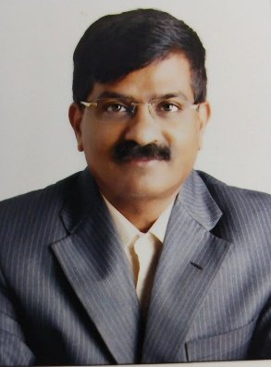
Sanjay Khanvilkar
Sanjay Khanvilkar is the first-generation entrepreneur; he was holding position of Chairman & Managing Director of Sanjay Maintenance Services Private Limited, (SMS) for more than two decades,
SMS was the first Indian Company who has introduced concept of Integrated Facility Management in India. In the year 1968, SMS has started FM services in India.
In the year 2000 Sanjay has taken over position of CMD from his father. Under Sanjay’s leadership, SMS had spread wings across India with turn over of more than 2.8 Billion with team size of more than 15,000 trained employees.
Sanjay has created milestones in Industry by innovative business techniques, which helped clients in various ways like Financial savings, Optimum utilization of available resource.
In 2017 Mr. Khanvilkar sold the brand SMS to one of the private equity and thereafter he had a non- compete clause of five years which got completed on 22nd March 2022. Mr. Sanjay will shortly come on the board of I Smart Facitech Pvt Ltd (Formally known as “Comfort Facility Management Services Private Limited” and before that “Comfort Facility Management Services LLP”)
EXECUTIVE SUMMARY

Slide 3
ORGANIZATION BACKGROUND
I Smart Facitech Pvt Ltd, Formally known as “Comfort Facility Management Services Private Limited” and before that “Comfort Facility Management Services LLP (CFMS)” – Established in year 2017.
I Smart Facitech Pvt Ltd provides Integrated Facility Management Services and Manpower Outsourcing solutions to various industries – Right from Corporate industry to Manufacturing industry, Aviation Industry, Retail Industry, Warehousing industry, Health care, Residential societies and Villas.
Our vast experience and expertise has enabled us to provide reliable and cost-effective solutions for every organization.
We provide services to all business segments in India as well as in European regions.
With our best services and customer satisfaction, our brand has become synonymous with trust and reliability.
ORGANIZATION BACKGROUND

Slide 4
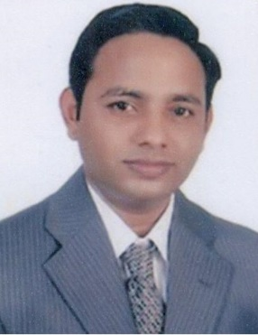
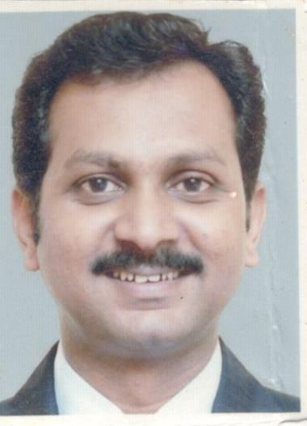
CORE TEAM:
Vinayak Bhise
Vinayak’s competencies lies in aligning business strategies with organisational goals & value system.
Vinayak is blend of converting strategy into execution as well he is strong believer of technology implementer in business operations.
He is heading the Finance and new Innovations in the Company.
Manoj Kambli
Manoj is an Associate Director of I Smart Facitech Pvt Ltd, he carries more than 18 years of hard-core experience in Manpower Outsourcing, Integrated Facility Management Services, Liasoning & Compliance Management.
His last assignment with SMS was in the capacity of General Manager HR & IR.
EXECUTIVE SUMMARY

Slide 5
ORGANISATIONAL STRENGHTS
Customer Centric
Trained & Skilled Resources
Compliance, Regulations
&
Guidelines
Technology
&
Innovation
Specialized in Planning & Scheduling
Uniformity
& Sustained Quality Output
Employee Engagement
Honest and Transparent Business Dealing
Efficient Online & Offline Training Systems
Centralize Operations Team
ORGANISATIONAL STRENGHTS

Slide 6
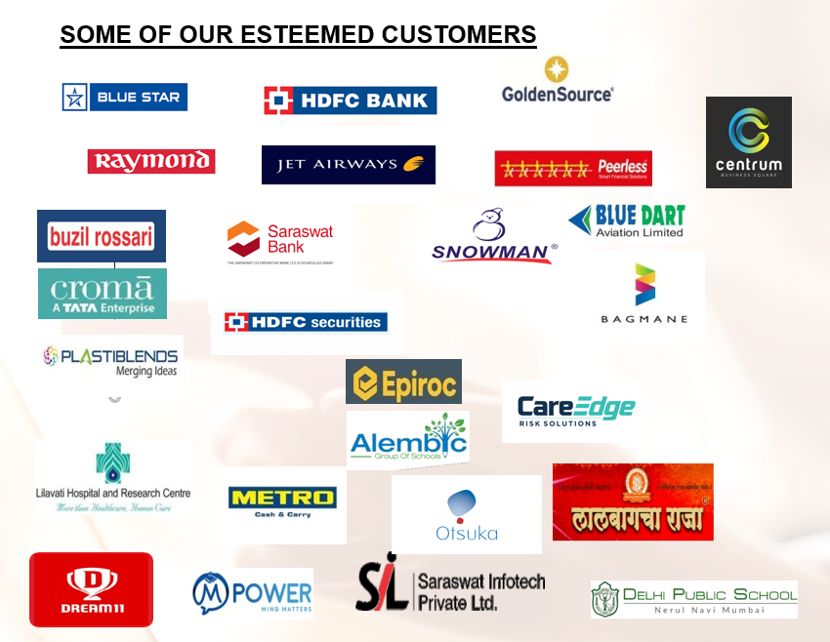
Our Esteemed Clients

Slide 7
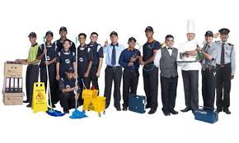

SERVICE BOUQUET
SOFT SERVICES
ELECTROMECHANICAL & MAINTENANCE SERVICES
Housekeeping Services
Pantry Services
Travel Desk
Front Desk
Pest Control / Fumigation / Sanitisation
Land Scaping & Horticulture
Event Management Services
Facade Cleaning
Concierge Services
Office Support Services
Project Cleaning Services
Chandeliers Cleaning & Servicing
Club House & Swimming Pool Management
Chair & carpet Shampooing
Home Cleaning Services
App Base Society & Visitors Management
Old Age Care Services
Patient Caretaker Services
Gym & Yoga Trainers
Waste Management / Garbage Disposable
Pigeon Net & Safety Net services
Vehicle Cleaning & Care Services
Water Tank Cleaning Services
Guest House Management
Chillers & Common area AHU Maintenance
Mechanical ventilation System
Fire Alarm & Fire Fighting System
New Elevator & Maintenance Services
Stacker & Puzzle Parking Solutions
Asset tagging
Fit out Management
Coordination for Annual Maintenance Contract
Procurement of Spares & Consumables
Repair & Maintenance Services
Electrical Plumbing & Carpentry Services
CCTV Operations & Maintenances
Automated BMS Operations
Intercom, Internet / Cable Services
Building Painting Services
Solar Systems
D G Set Services
R O Plant Services
Sewage Treatment Plant (STP)
Water Restoration / Rain Harvesting
SERVICE BOUQUET

Slide 8


SERVICE BOUQUET
TEMPORARY STAFFING
LIAISONING & DOCUMENTATION SERVICES
Sourcing
Recruitment
Managing Take Over Staff
Payroll Management
Compliance Management
Grievance handling
Supervision & Administrative support to Client
HRMS Support to Client & Staff
Adhering to Society Bye Laws
Account & Banking of Society as per Bye Laws
Auditing (Quarterly, Half Yearly & Annually)
BMC Liaison support
Labor Office Liaisoning (Central / State)
SERVICE BOUQUET

Slide 9
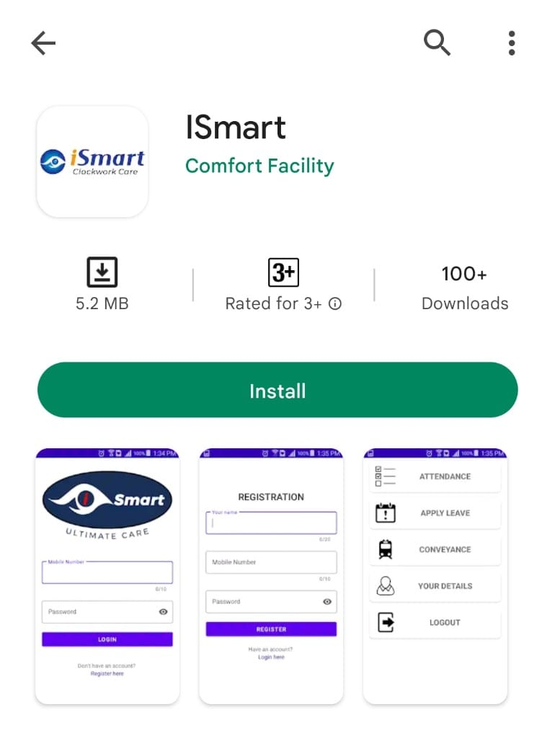
Ismart APP:
Attendance and Employee Self Service App:
Attendance and ESS App

Slide 10
Why ISmartIFM (Operation App) :
Challenges
Smart IFM
Report Analysis
Manual Tracking and control of tasks
Digitised Responsibility.
Reddy Report
Planning through statistic Analysis
Pre-Scheduled Task
Decision making
Dependency on Excel sheet
Task Alter and Reminders
SMS & Email Escalation
Operation App
Real Time data and Dashboard
Fast Response & Follow up

Slide 11
Contact Us :-
I Smart Facitech Pvt Ltd
(Formerly known as “Comfort Facility Management Services Private Limited” and before that “Comfort Facility Management Services LLP”)
317, 3rd Flr, Nilgiri Premises CS, Wadala Truck Terminal, Nr RTO, Wadala, Mumbai-400037; M : 9967759177; E: hr@ismartfacitech.com
Vinayak Bhise, M: 9152729982; E: vinayak.b@ismartfacitech.com
Branches :- Mumbai I Vadodara I Bangalore I Hyderabad I Indore I Delhi I Jaipur I Chennai
THANK YOU
THANK YOU

